Slide 1
Income Prediction with height and bodytype
Machine Learning Fundamentals
Johnny Zhang
January 5th, 2019

Slide 2
Table of Contents
Exploration of the Okcupid Dataset
Question to Answer
Augmenting the Dataset
Classification approaches
Regression approaches
Conclusions/Next Steps

Slide 3
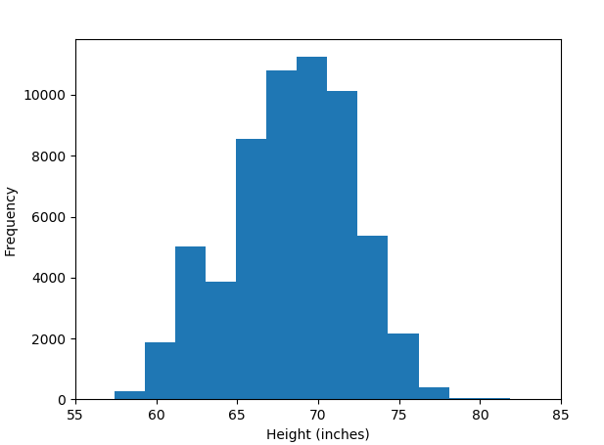
Histogram of height distribution
This is a histogram of the distribution of heights, with the most frequent height at 70 inches which converts to around 5’10. Tallest brackets are around 6’7 and lowest bracket around 4’10

Slide 4
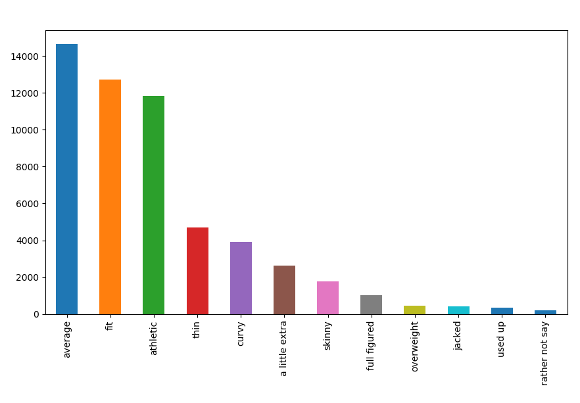
Frequency of each body type
This is a bar graph that shows the value counts of the category body_type.
The most frequent body_type is average.
Interestingly it seems that the majority of users on OKCupid would describe themselves as fit, average, or athletic which is the western civilization beauty ideal.

Slide 5
Question to Answer
There have been studies that have shown that physical attraction plays a significant role in getting hired for a higher paying job
Here I’d like to take a look using two physical attributes, height and body_type of the people to try and predict their income.

Slide 6
Augmenting the Dataset
Mapping Height: It already is a continuous value so there is no need to augment it.
Mapping body_type: I have mapped df.body_type as the following
Rather not say: np.nan(I want to remove this later as it doesn’t help predictions)
Used up: 0 (didn’t know that was a setting haha)
Overweight: 1
Full figured: 2
Curvy: 3
A little extra: 4
Average: 5
Skinny: 6
Thin: 7
Fit: 8
Athletic: 9
Jacked: 10

Slide 7
Augmenting the Dataset
Mapping categories of income: I have mapped df.income as the following
-1: np.nan(I want to remove this as there is no difference between -$1 and-$10,000,000)
20,000: 1(didn’t know that was a setting haha)
30,000: 2
40,000: 3
50,000: 4
60,000: 5
70,000: 6
80,000: 7
100,000: 8
150,000: 9
250,000: 10
500,000: 11
10,000,000:12

Slide 8
Classification Approaches
K-Nearest Neighbor using body_type and height as features with income as a label.
Income is converted into categorical values as they are inputted into OKCupid
Income of negatives is removed due to it being a catch-all category for everything below 0 be it -$1 or -$10,000,000

Slide 9
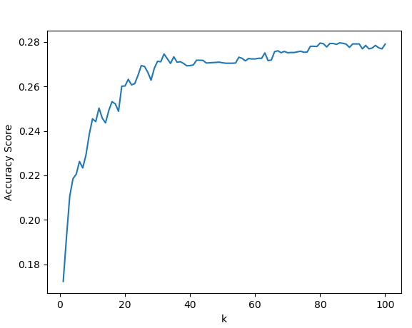
K Nearest Neighbors
Accuracy is calculated using sklearn.metrics accuracy_score
Accuracy hovers around close to 28% with varying k’s

Slide 10
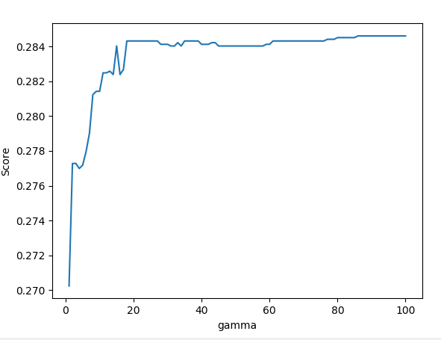
SVM
Using gamma=20, and the default kernel rbf,
We fitted our SVC and obtained a score of also around 28%

Slide 11
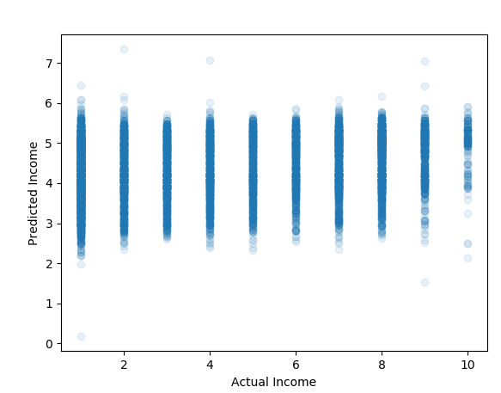
Multivariate Linear Regression
Using height and body type as features, I ran a multivariate linear regression and obtained an R^2 of 0.00431, unable to predict the income using height and body type.

Slide 12
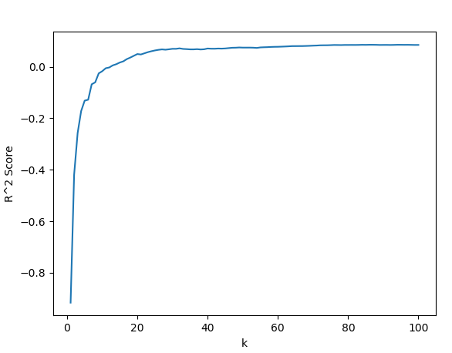
K Neighbors Regressor
Received an R^2 score of 0.075 at k=50
Slight improvement upon multivariate linear regression but not much.

Slide 13
Conclusions
Since there are 12 categories and 1/12 =0.0833 or 8.3%
Our SVM and K-nearest Neighbor classifiers were able to perform 28% with varying values of k and gamma.
We are able to much better predict than chance the income of a person based on their height and body-weight.
However, correlations in multivariate analysis and K nearest Neighbor regressions were both weak.
More data such as objectively rated attractiveness can be a better feature to predict income. As I do believe that based on our data that certain physical features predispose an individual to having higher income. Rated attractiveness by other users on Okcupid would be a great metric to test.

